Slide 1

Anti Money Laundering using AI/ML :
Mentor : Anurag Nawal
Team:
Shardul Patil (Lead)
Samiksha Dhadam
Kushankur Chakraborty
Prithvi Venkatesh
Akashta Ambiga
Aishwarya Soni
Dhanajay Aghav
Nitin Gavhane
Rupali Wagh

Slide 2
Problem Statement :
To create an solution for Money Laundering which reduces review operation costs by lowering the number of False Positive alerts generated by current static rule based Anti-Money Laundering Alert Systems.

Slide 3
Overview :
Building a ML-Model that can accurately detect fraud and decrease False Positives and False Negatives

Slide 4
Objective:
The aim of the project is to build a binary classification model
That can detect suspicious companies based solely on publicly available data from the Companies House website.
The product would be used in conjunction with existing AML procedures to flag companies that require further investigation.

Slide 5
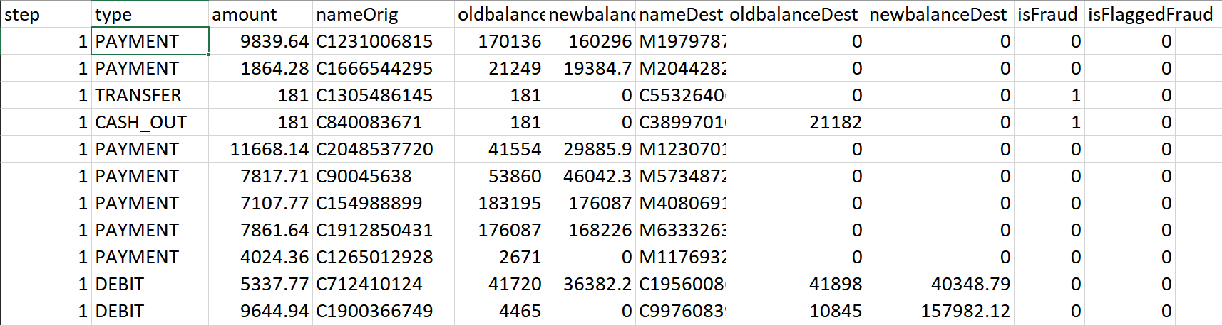
Dataset :
Synthetic Data based on Real Log Data
6.3 Million Records

Slide 6
Features Set (X)
step: The time step of the transaction.
type: The type of transaction (e.g., PAYMENT, TRANSFER, CASH_OUT).
amount: The transaction amount.
nameOrig: The originator's account name.
oldbalanceOrg: The original balance in the originator's account.
newbalanceOrig: The new balance in the originator's account after the transaction.
nameDest: The destination account name.
oldbalanceDest: The original balance in the destination account.
newbalanceDest: The new balance in the destination account after the transaction.
isFraud: A binary indicator (0 or 1) indicating whether the transaction is fraudulent.
isFlaggedFraud: Another binary indicator (0 or 1) for flagged fraudulent transactions.

Slide 7
Solution
Cleansing and Preprocessing
Encoding Data
Model Fitting
Result Matrix
Insight Generation

Slide 8
Comparative Analysis
We have done a comparative analysis of Multiple Models
Logistic Regression
SVMs
Decision Tree
RFT
DNNs

Slide 9
Findings
Decision Tree
Training < 1m
Higher Accuracy
Suited for DataSet Size
DNNs
Longer Training Time
Higher Capacity for Tuning

Slide 10
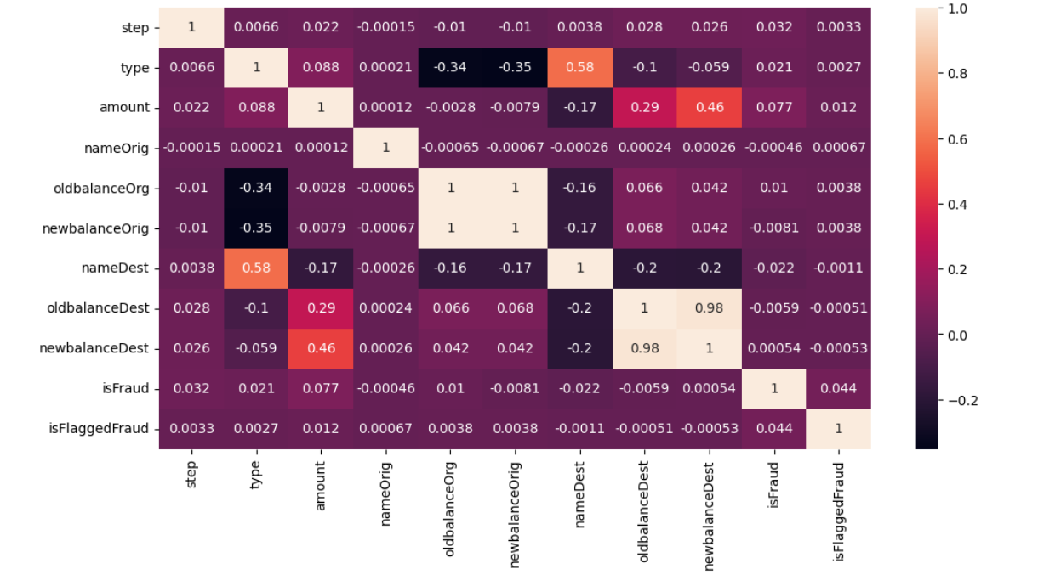
Co-Relation Heat Map:

Slide 11
Results:
Decision Tree
Precision: 88%
Recall : 87%
F1: 78%
Deep Neural Network
Precision: 99%
Recall : 59%
F1: 74%

Slide 12
Future Scope
Making it a Deliverable
Shifting to Real world Data
Interactive Front-end and Dashboards

Slide 13
Thank you

